Slide 1



Mobile development

Slide 2

Plan de la présentation
Introduction
Mobile applications
Qt overview Focus on QtQuick
Workshop Q/A

Slide 3
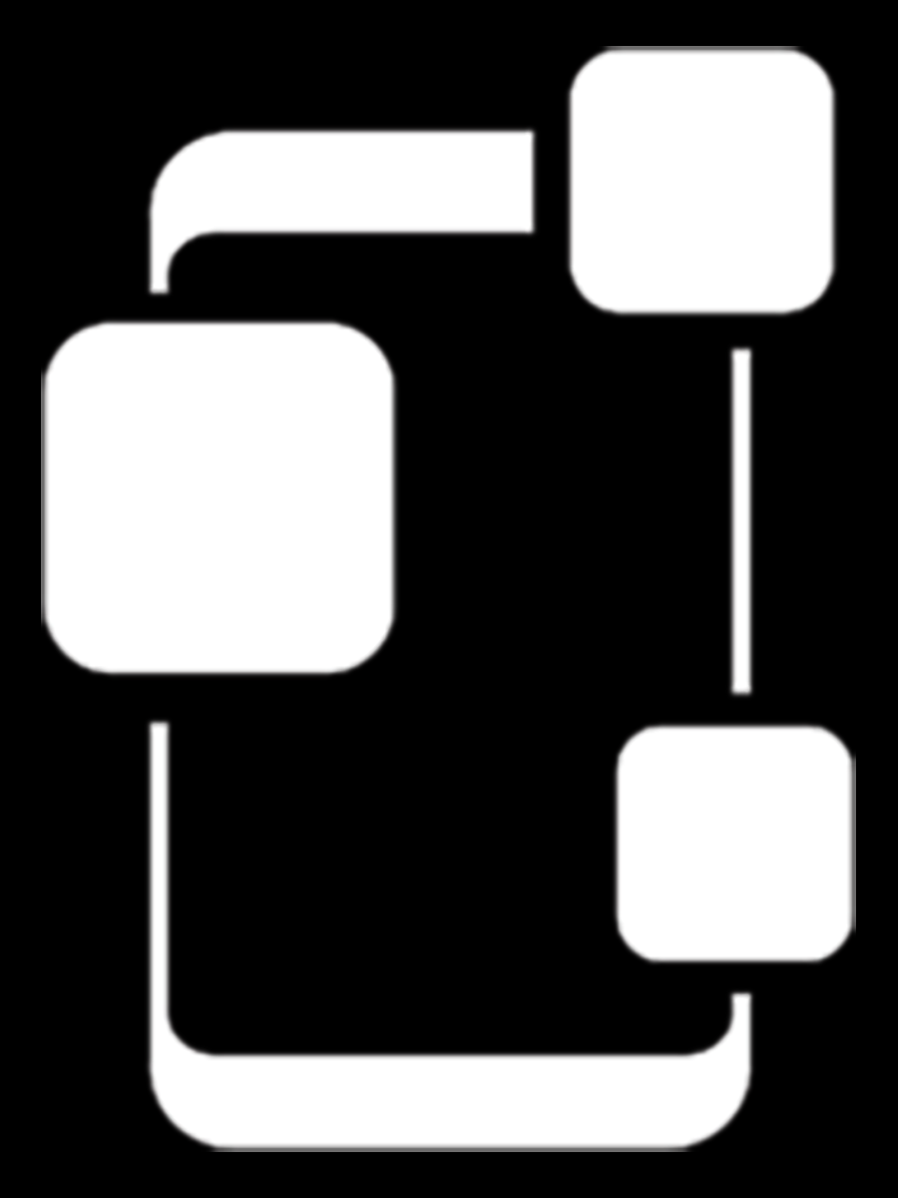
Mobile applications
1

Slide 4
a few numbers
French market share per OS
© Mobile Marketing Association France
july 2016

Slide 5




How many applications available per store ?
Statista – June 2016

Slide 6
La fragmentation des smartphones
Google - 5 september 2016
Statista- 16th of September 2016
30 well known integrators
more than 25 000 model !
300 screen size from 2 to 10’’
from 120 to 640 dpi
~30 models (iPhone, Ipod, iPad)
4 iPhone screens (3.5, 4, 4.7, 5.5), Retina…
around 12 CPU : ARM, A4, A5X, A6, A10…
Memory from 256Mb to 4Gb

Slide 7
How long / how much to develop an app ?
11%
24%
28%
11%
17%
9%
Month
1 à 3
4 à 6
7 à 9
10 à 12
> à 12
nsp
14%
21%
17%
19%
18%
11%
< 50k
50 à 100k
100 à 200k
200 à 500k
500 à 1M
nsp
average cost of 270 k$
Source : kinvey report (2014)
Development cost is often underestimated with a 3 factor (Forrester)

Slide 8
How much does it cost ?

Slide 9
Cost factors
number of OS supported
Android
Features
Auth
how many pages
data
Camera
Sensors...
iOS
Windows...

Slide 10
Simulators
Otreva (http://howmuchtobuildanapp.com/)
Tusnua design (http://appestimator.tusnuadesigns.net/)
Imason (https://www.imason.com/mobile-app-calculator)
Kinvey (http://www.kinvey.com/app-cost-estimator)
Propelics (http://www.propelics.com/enterprise-mobile-app-cost-calculator/)
Kony (https://www.visualize-roi.com/launch/kony/cloud/)
Crew (http://howmuchtomakeanapp.com/)
Wasp (https://waspmobile.com/services/mobile/app-cost-calculator/)
Oozou (https://estimatemyapp.com/)
Yeeply (https://www.combiencoutemonapp.com/)

Slide 11
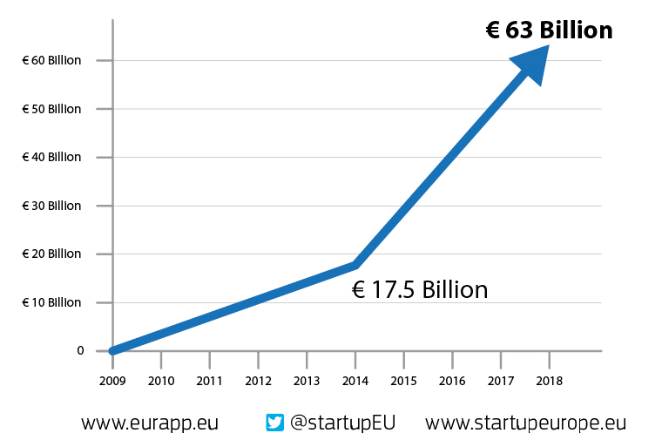
Perspectives
« through 2017, the market demand for mobile app development services will grow at least five times faster than internal IT organization capacity to deliver them. »
Gartner, The Enterprise App Explosion : Scaling One to 100 Mobile Apps, Adrian Leow, 7th may 2015
From Eurapp (2014) between 2013 and 2018 :
number of devs will grow from 1 to 3 M
helpdesk staff from 800k to 2.1M

Slide 12



Different ways for building an app
Web
available using a browser
Web mobile
Mobile optimized website
Adaptative design / Responsive design
JQuery, Vaadin, Angular JS, Ember, Backbone.js, React/Flux
Web App
web mobile having an app look & feel
App
downloadable from a store
PhoneGap (Apache Cordova), Rho Mobile, Ionic, Sensa Touch, Intel SDK, Onsen UI, JQuery mobile, Mobile Angular UI...
Hybrid
Contenu dans une application
Native CPF
Qt (C+, QML, JS), Xamarin (C#), Appcelerator Titanium (JS), Ruby motion (Ruby), Unity (C#,BOO), Marmalade (*), ...
Native
Java
Objective C / swift
C#

Slide 13

Qt overview
2

Slide 14
What is Qt ?
Concept
Promise
Langage
Tools
Library

Slide 15










What is Qt ?
Network and communication, Multithreading, Multimedia and sensors, database, 3D (OpenGL), Web, XML, JSON, PDF...
A C++ library
A tool box
QtCreator, QtAssistant, GUI Designer, Build suite (QMake, QBS)
Concepts
QtQuick, Signals / Slots, Widget, Model-View-Delegate
licences
Propriatary, GPL, LGPL
a promise
“Code once, deploy everywhere !”

Slide 16
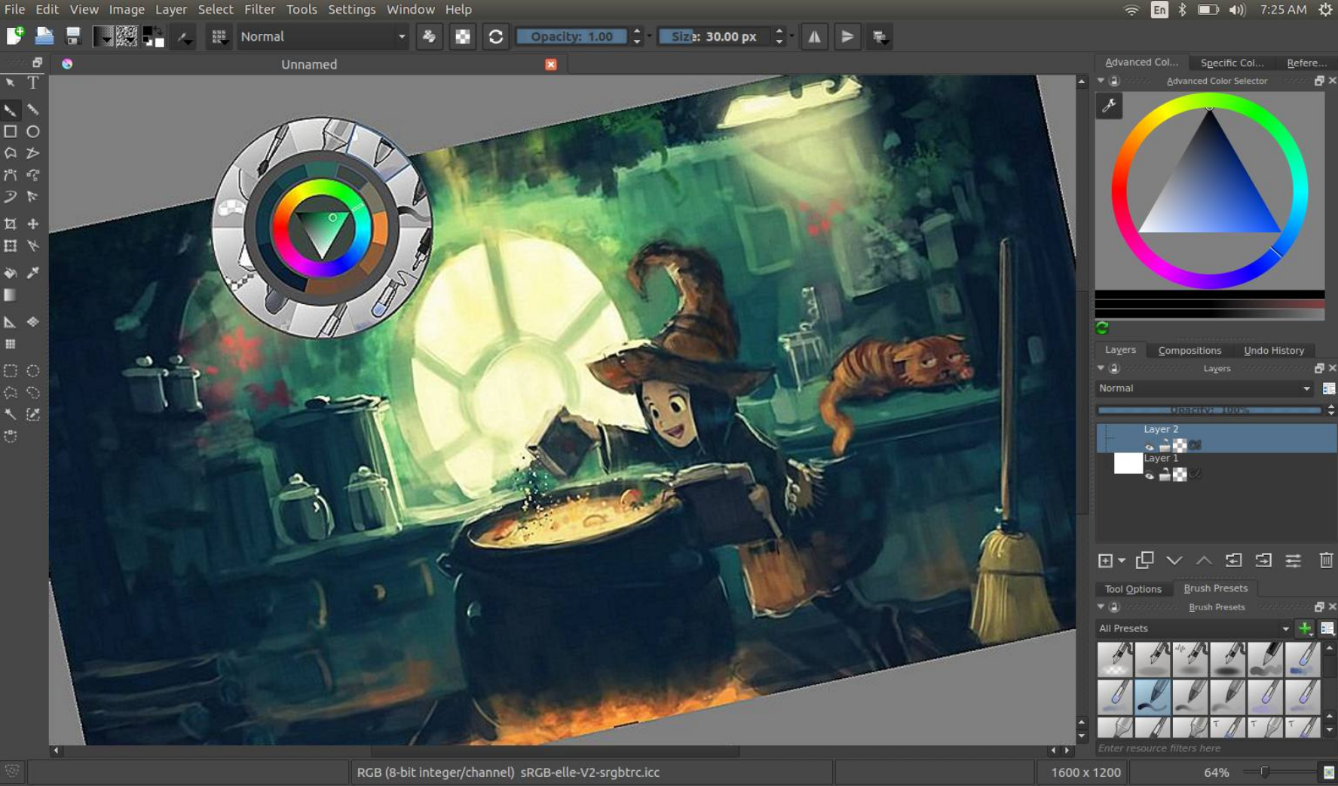
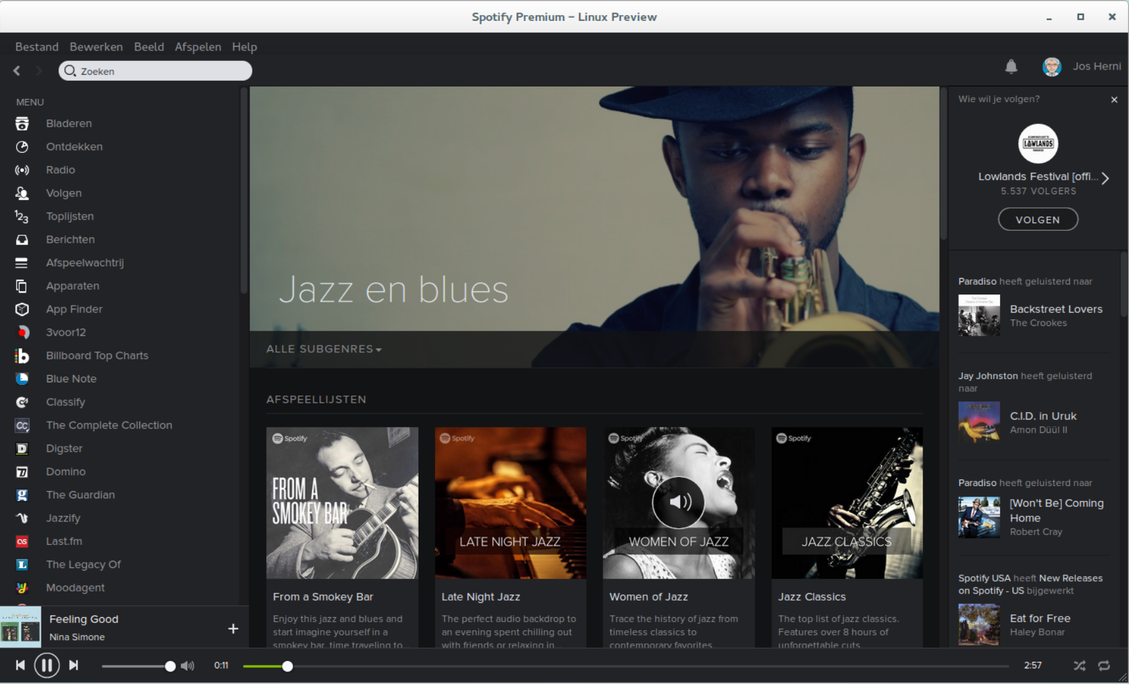
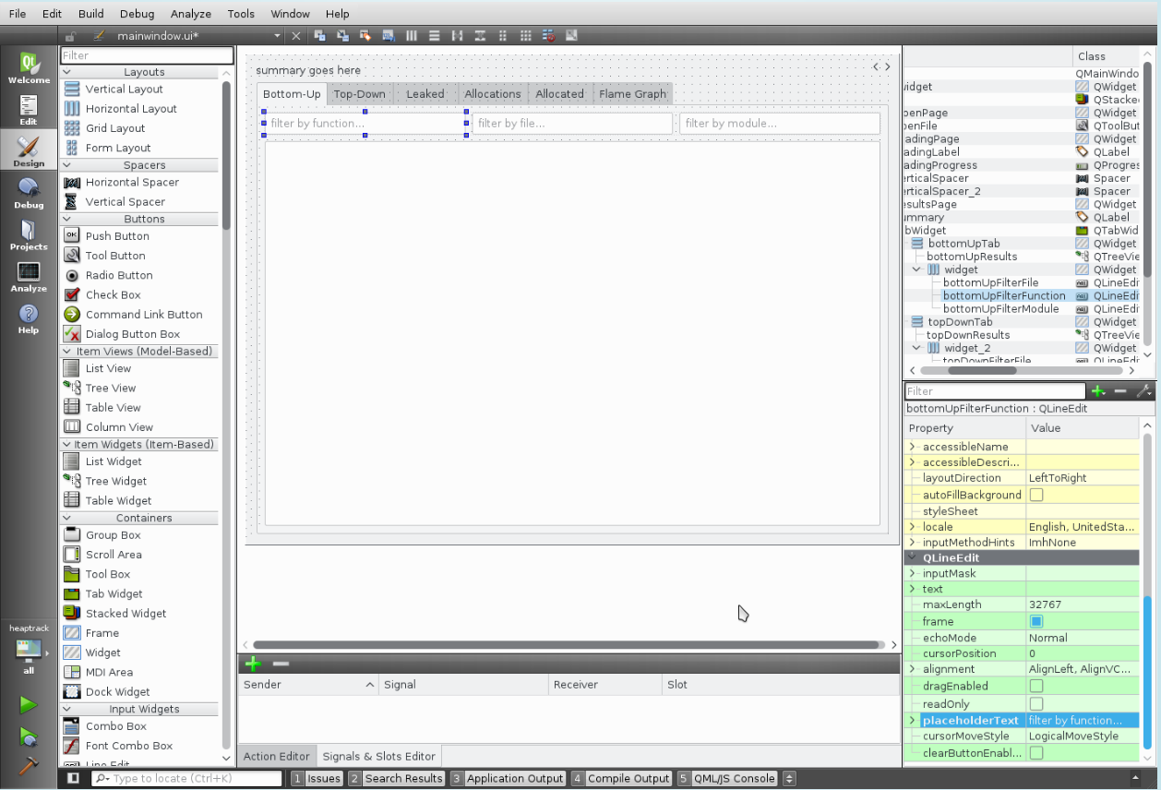
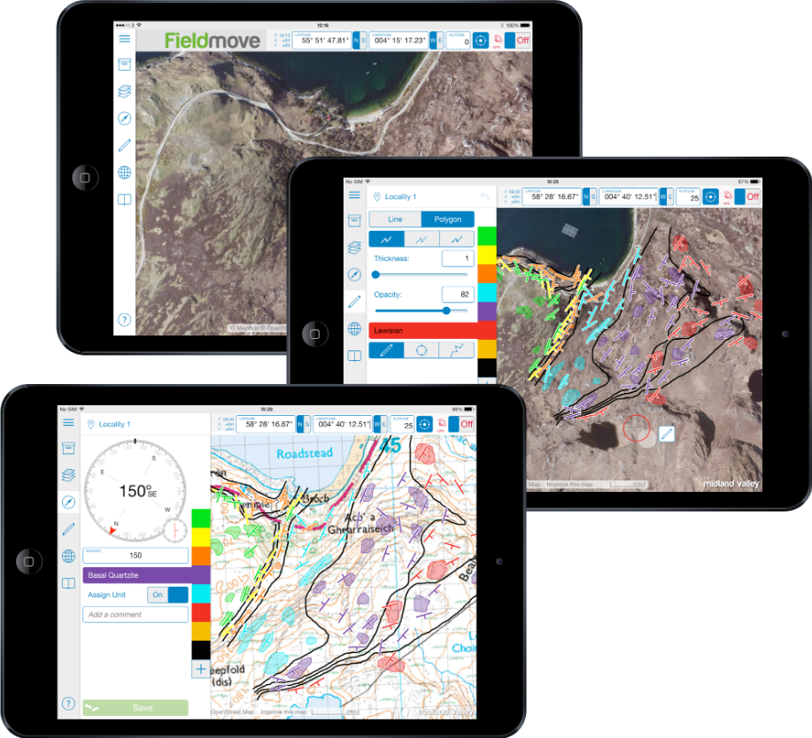
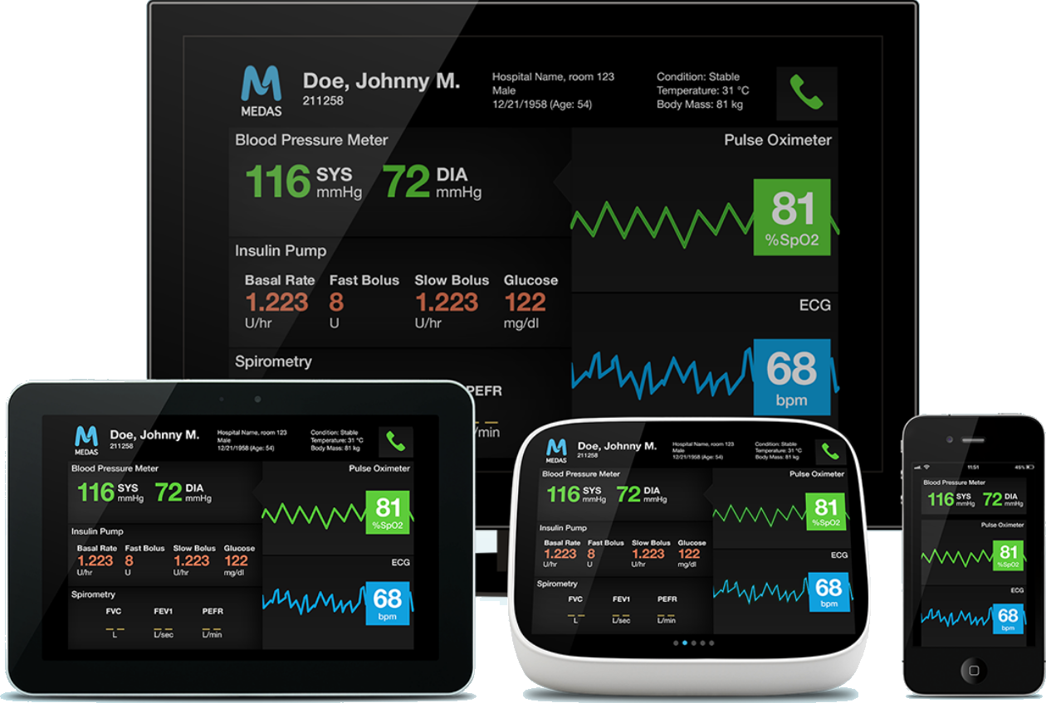
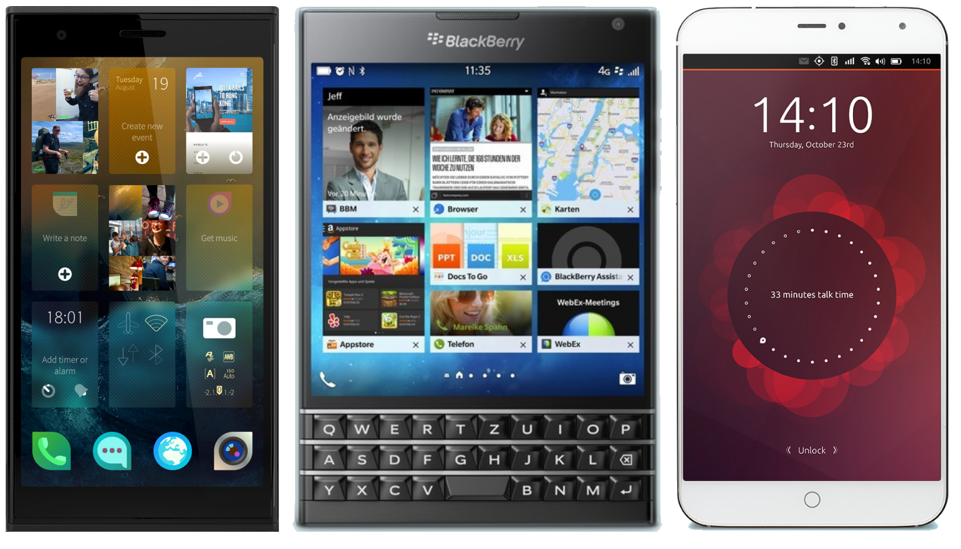
UI : several possible options...

Slide 17
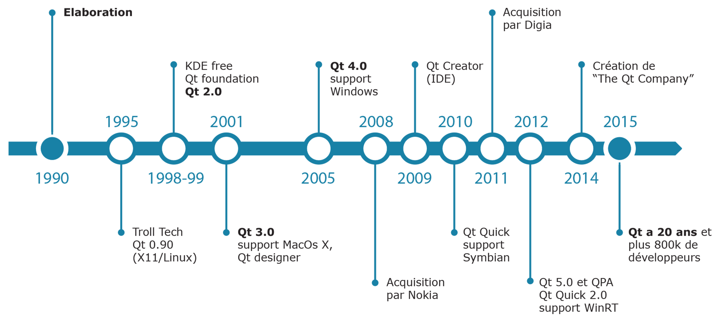
Historical

Slide 18
Historique releases Qt5 avec les améliorations concernant le mobile
5.0
19/12/2012 : QML, QtQuick, Location (géolocalisation)
5.1
03/07/2013 : Quick controls, Sensors (Android, iOS, Blackberry), Qt for Android (Technology preview), Qt for iOS (Technology preview)
5.2
12/12/13 : Positionning, NFC, Bluetooth, Windows Extra, Mac extra, Android extra, Qt for Android, Qt for IOS
5.3
20/05/2014 : iOS (input Method, word completion,...), Positioning (Android,iOS), Bluetooth(Android)
5.4
10/12/2014 : Bluetooth LE (Android only and Technology Preview), Qt for WinRT, limited iOS native style (popup menu, text selection)
5.5
01/07/2015 : Bluetooth LE, Qt3D, Location (Route), Canvas 3D, Webview (iOS)
5.6
16/03/2016 : Qt Speech (tech preview), QtQuick Controls 2.0 (tech preview)
5.7
15/06/2016 : Qt Speech, QtQuick Controls 2.0 avec style iOS, Material, Universal
5.8
2 releases per year !
23/01/2017 : Qt WebEngine, Network Auth (tech preview)

Slide 19

Focus on QtQuick
3

Slide 20
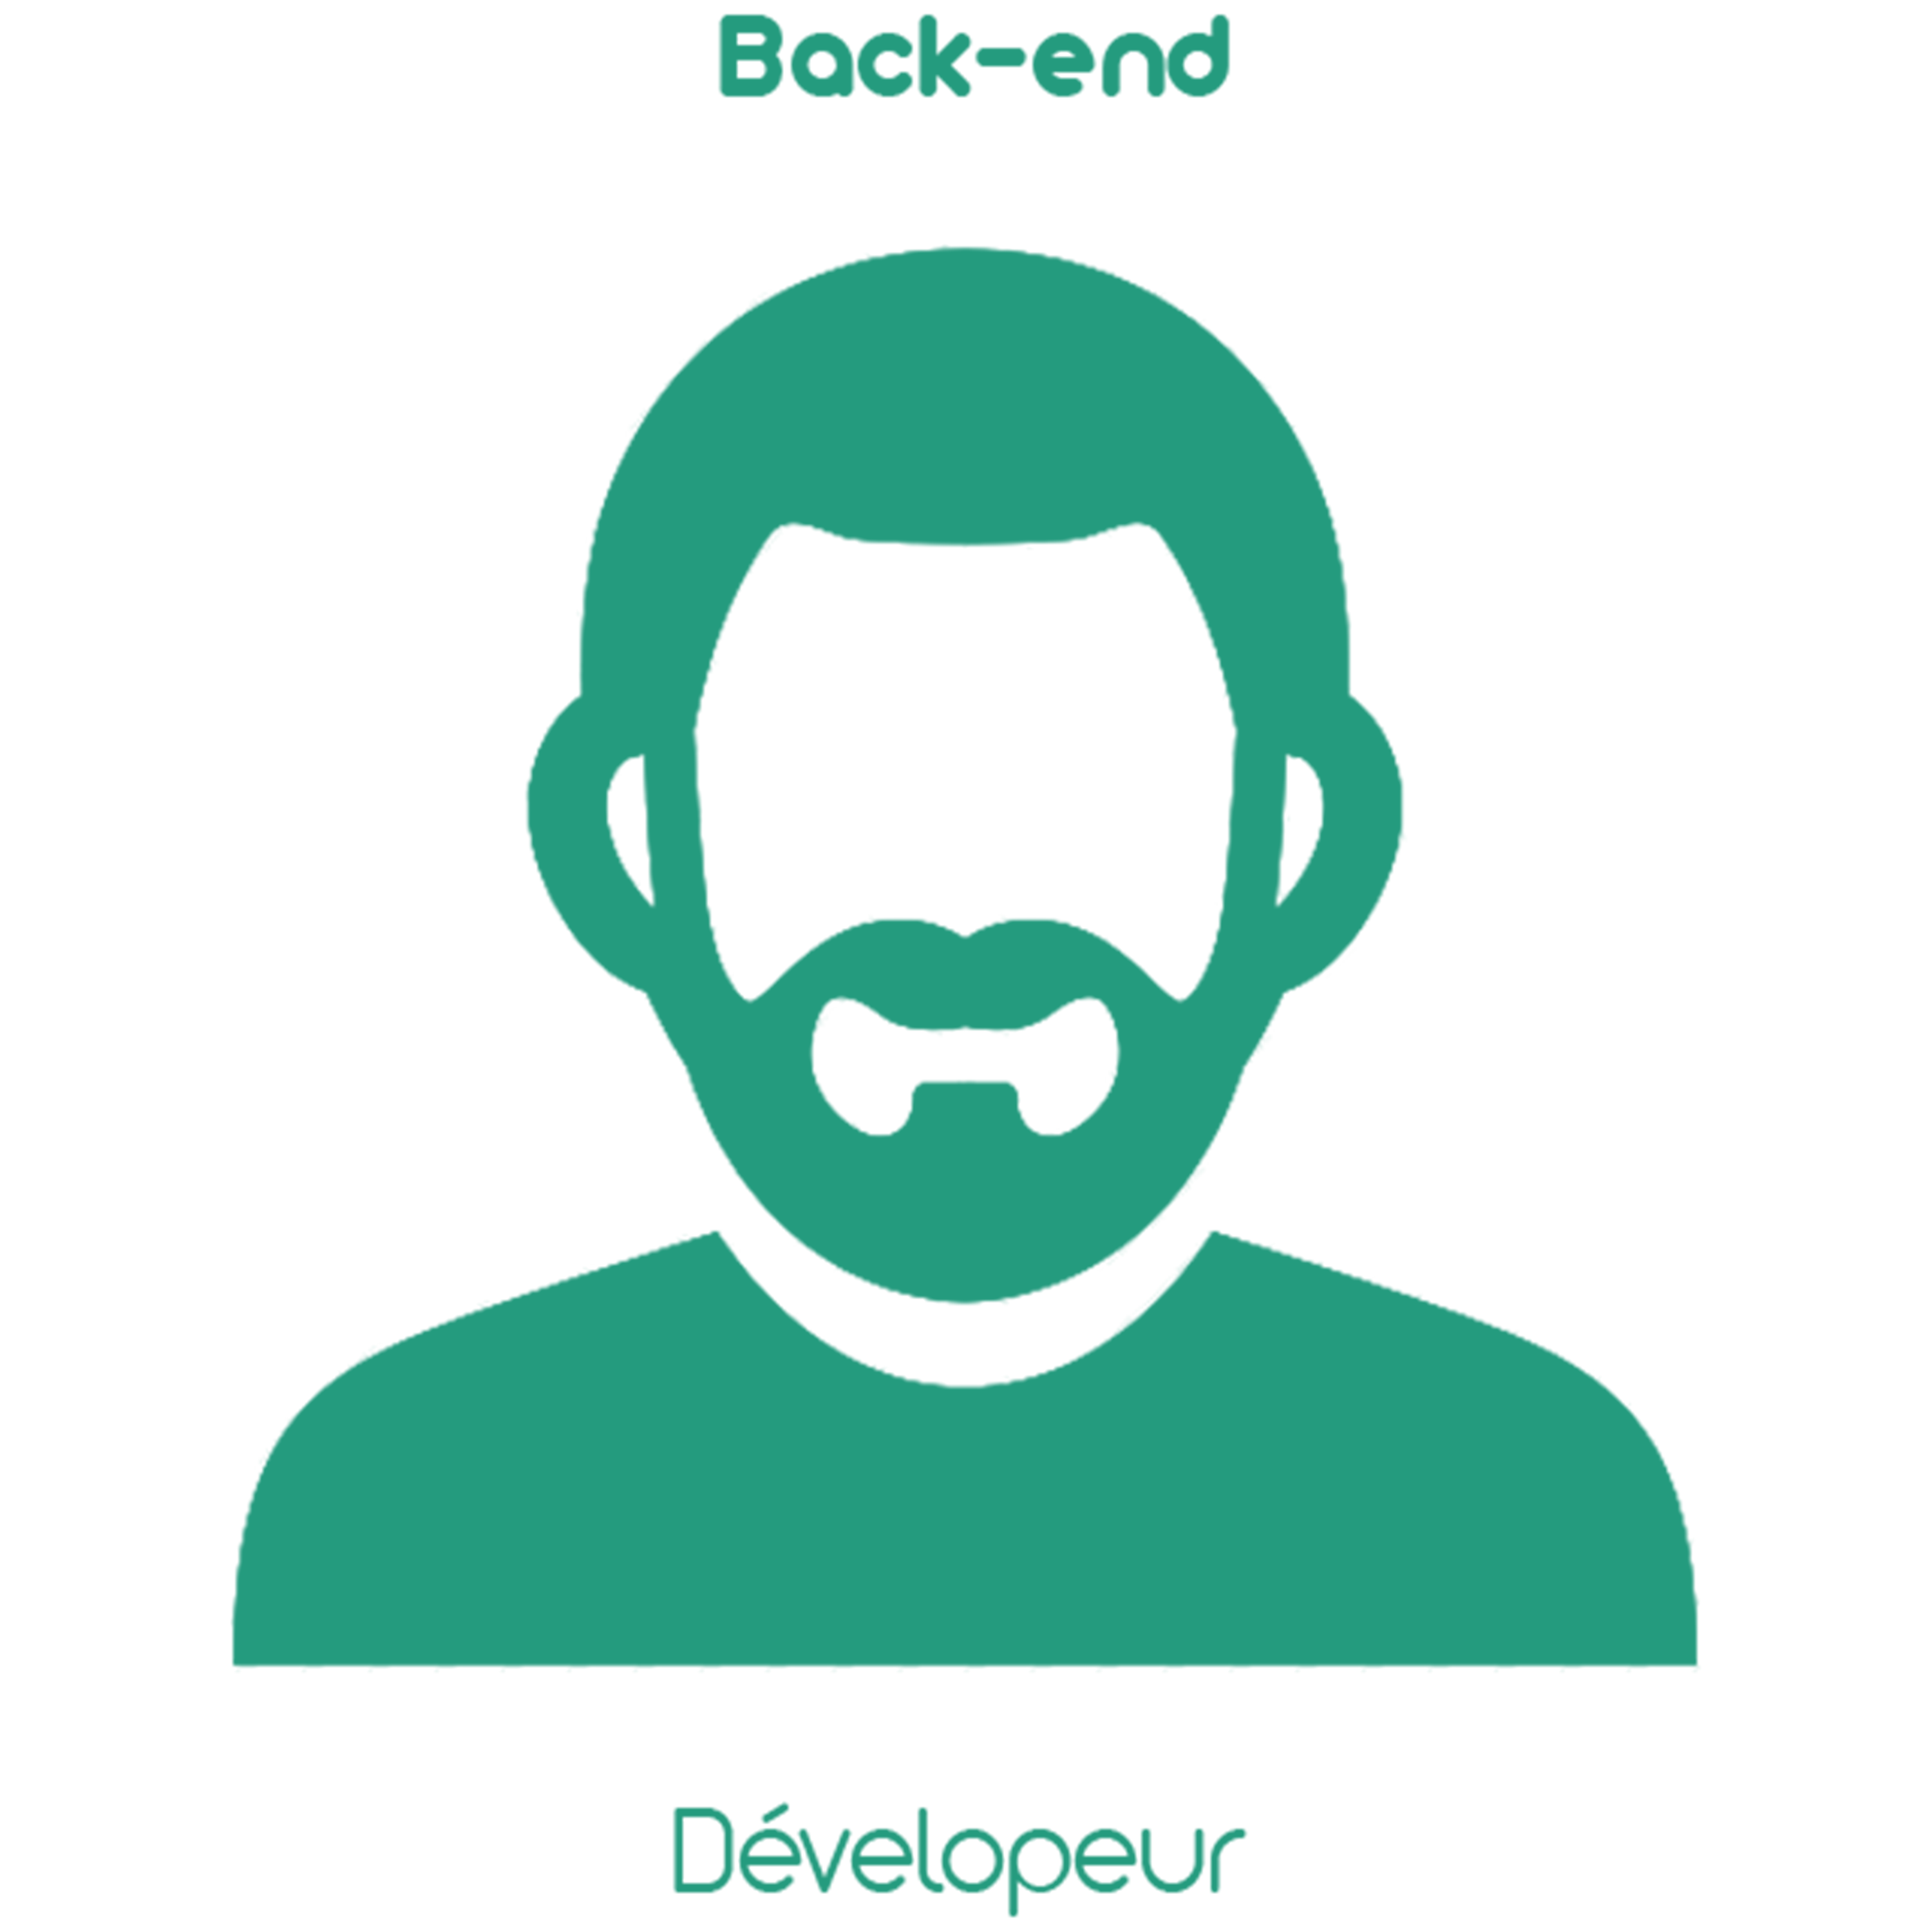
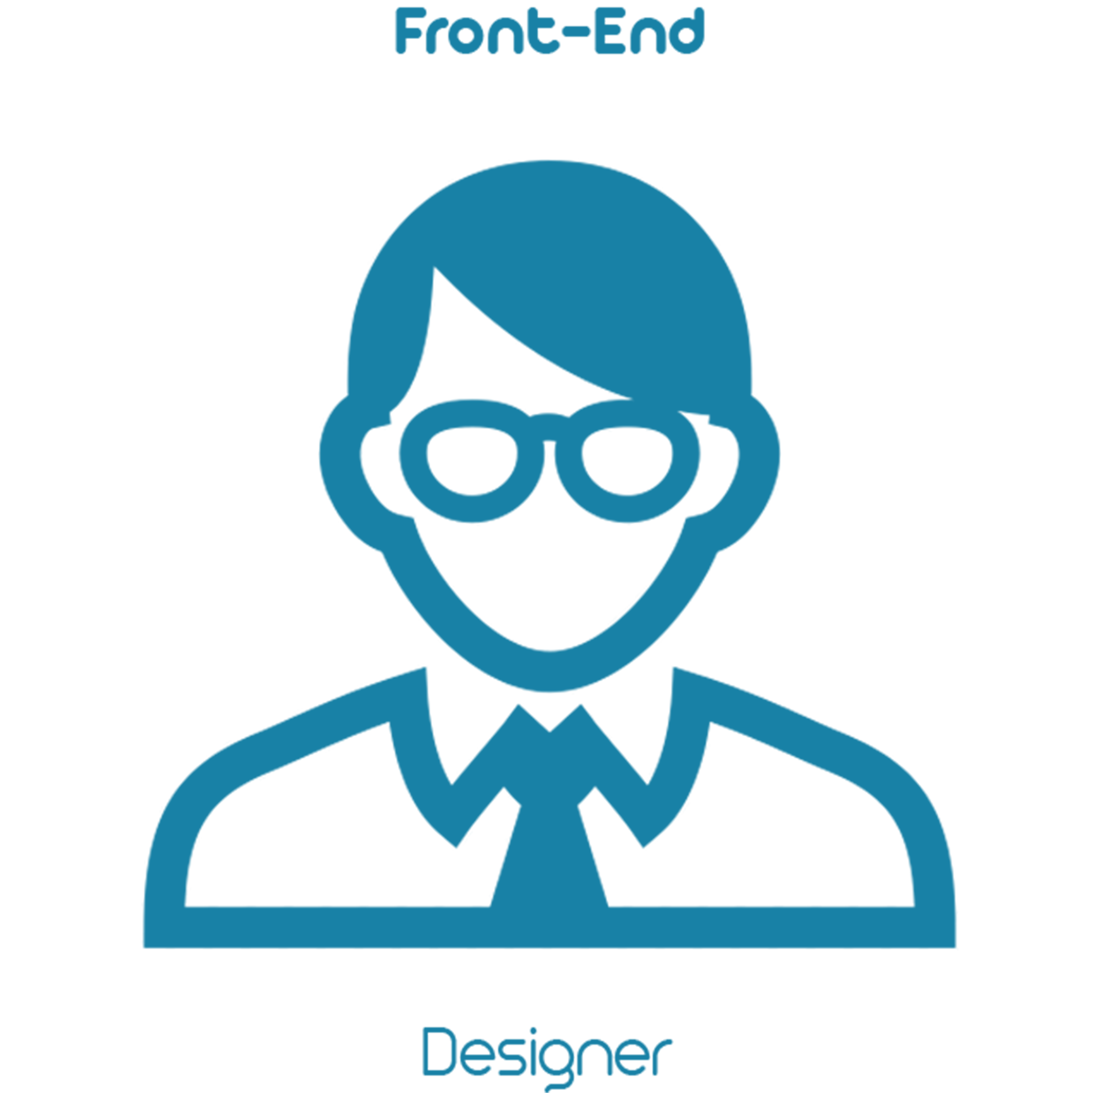

The QtQuick concept
Having the best of 2 worlds : C++ power serving stunning QML base UI !

Slide 21
What is it?
import QtQuick 2.0
Rectangle {
id: page
width: 320; height: 480
color: "lightgray"
Text {
id: helloText
text: "Hello world!"
y: 2 * 15
anchors.horizontalCenter: page.horizontalCenter
font.pointSize: 24; font.bold: true
MouseArea{
anchors.fill : parent
onClicked: { if (true) Console.log(parent.text)
}
}
}
}
Declarative langage
modularity (plugins)
Animation
3D hardware accelerated rendering
DOM model
ECMA compliant engine (javascript)

Slide 22
Overview of modules and QML types
QtQML
Binding Component Connections Date Instantiator Locale Number Qt QtObject String Timer
Basic
QtQuick
- Item
- Rectangle
- Image
- Text
- TextEdit
- TextInput
- Row
- Column
- Grid
- Flow
- Flipable
- Flickable
- MouseArea, MouseEvents, WheelEvents
- Shortcut, Key, KeyEvents
- PinchArea, PinchEvents
- Drag, DragEvent, DropArea
- ListView
- GridView
- Repeater
- ListModel
- Loader
- Animations
- States
Windows, Dialogs, Tests, Layouts, XML List models, Local Storage, Controls
Qt3D
QtNfc
QtAudioEngine
QtSensors
QtBluetooth
QtWebsocket
QtLocation
QtPositionning
QtWebview
QtTest
QtMultimedia

Slide 23

Thanks ! Let’s start the workshop...

